Slide 1

CODE HUB.
18th of September 2018

Slide 2
WHO IS KODKOLLEKTIVET?

Slide 3
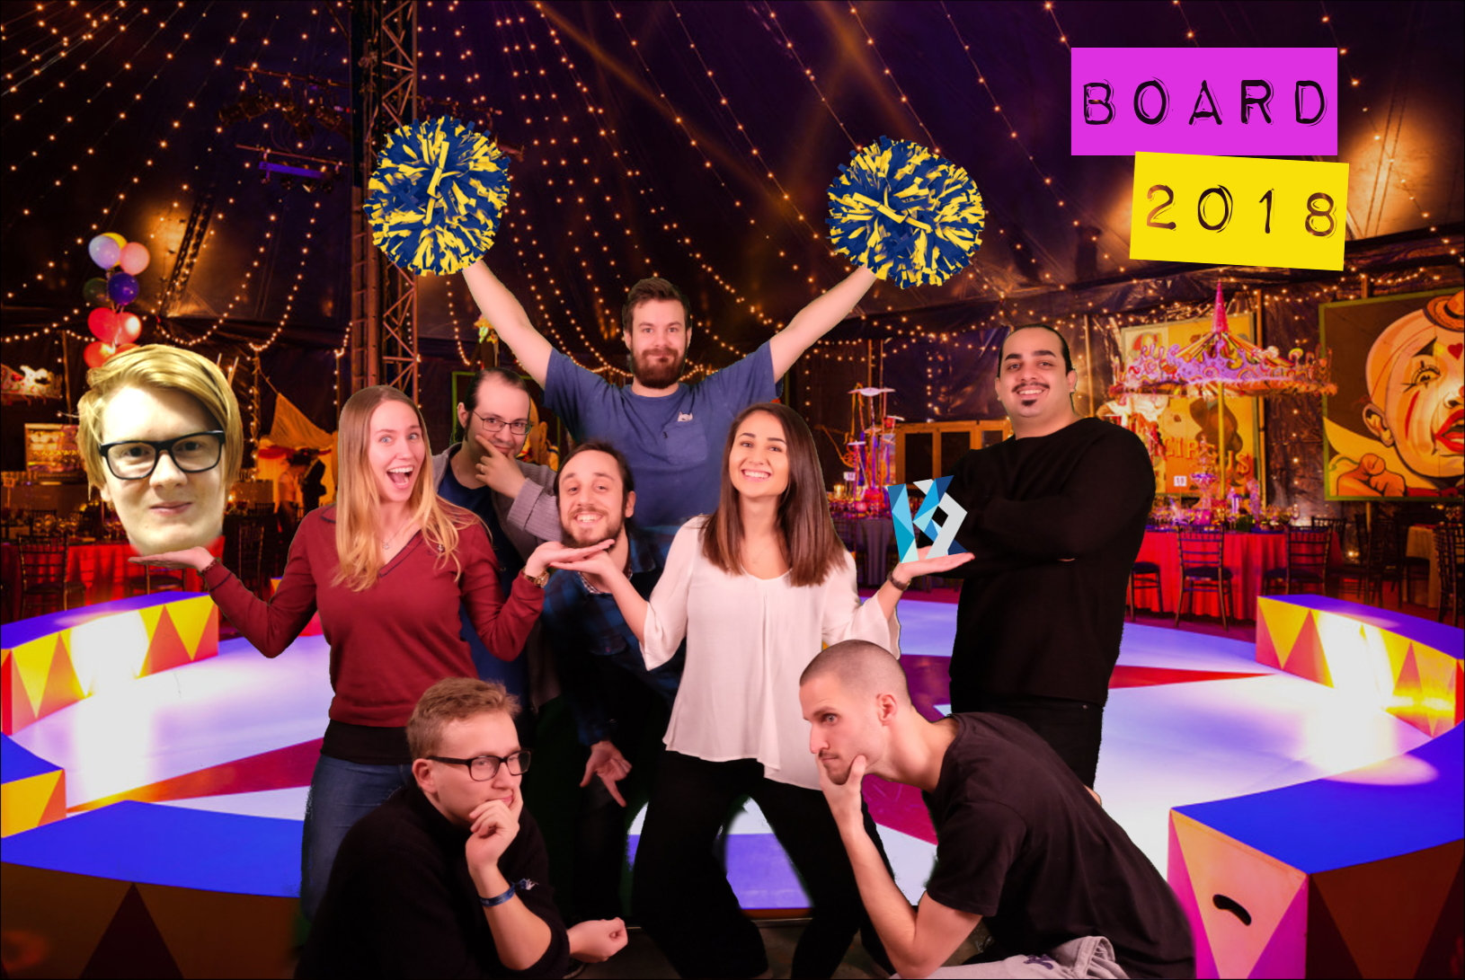
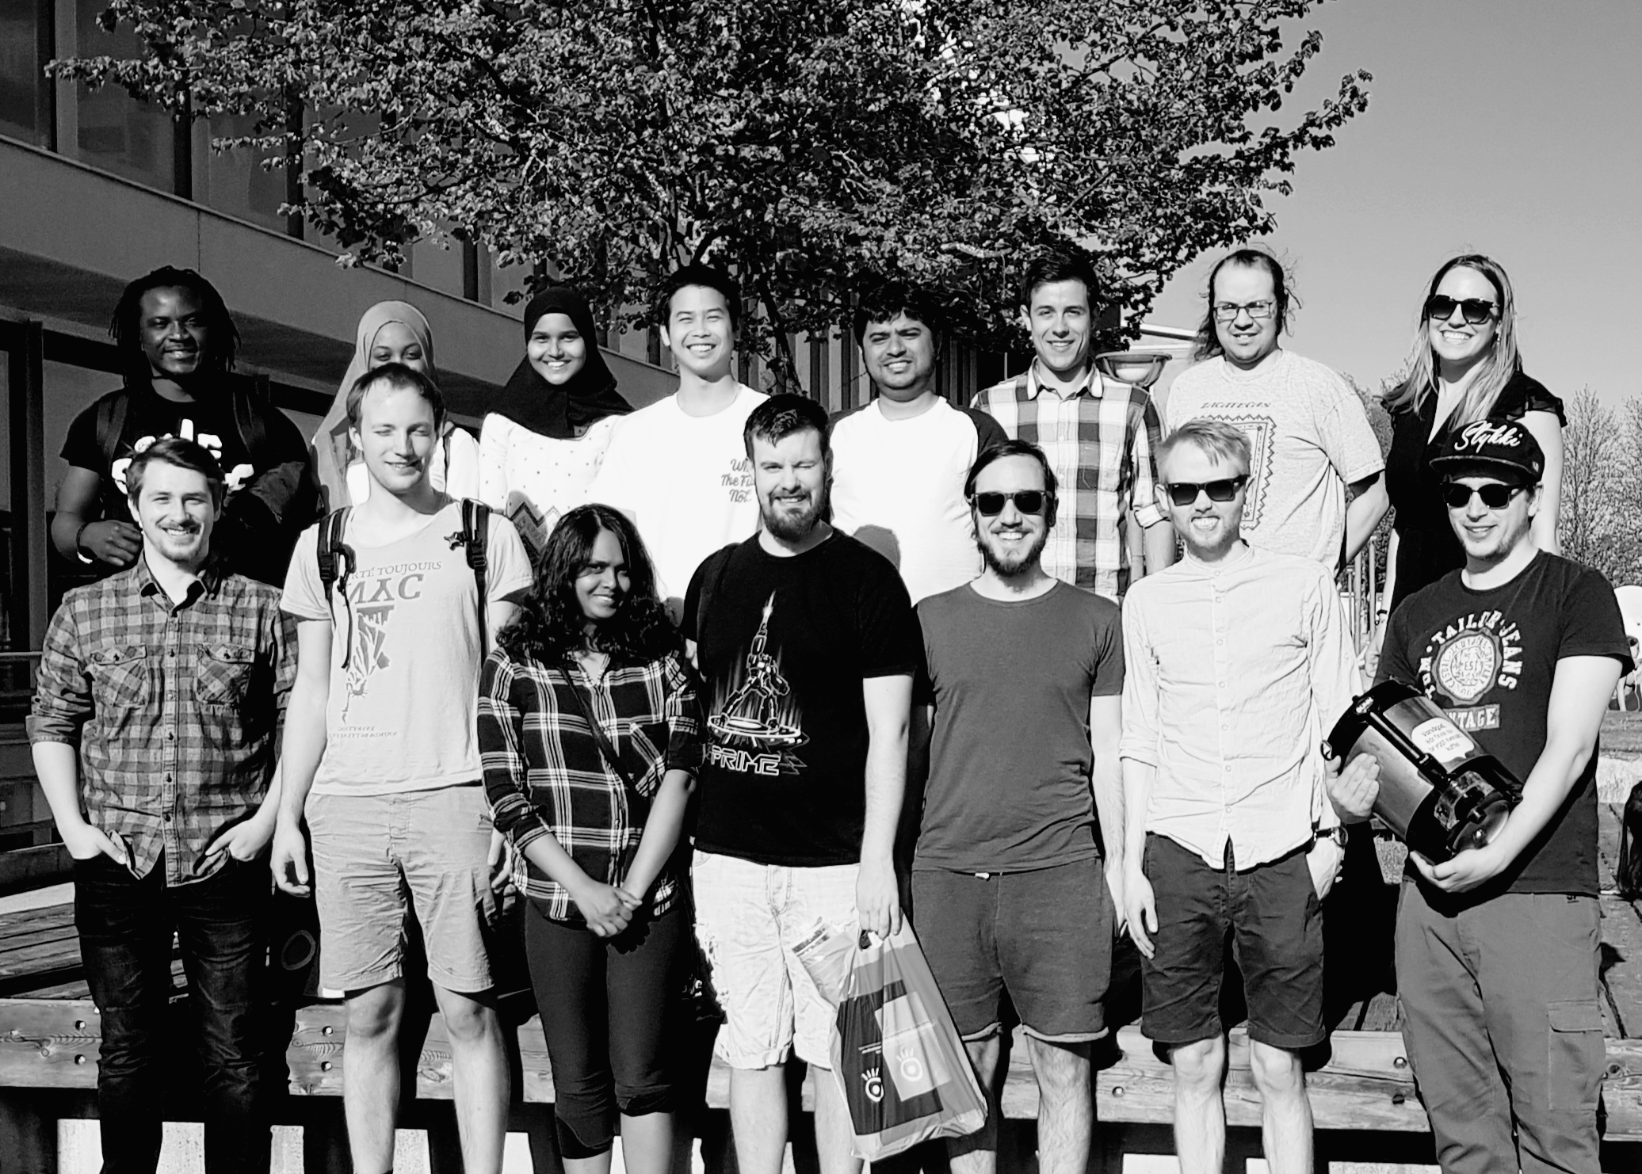
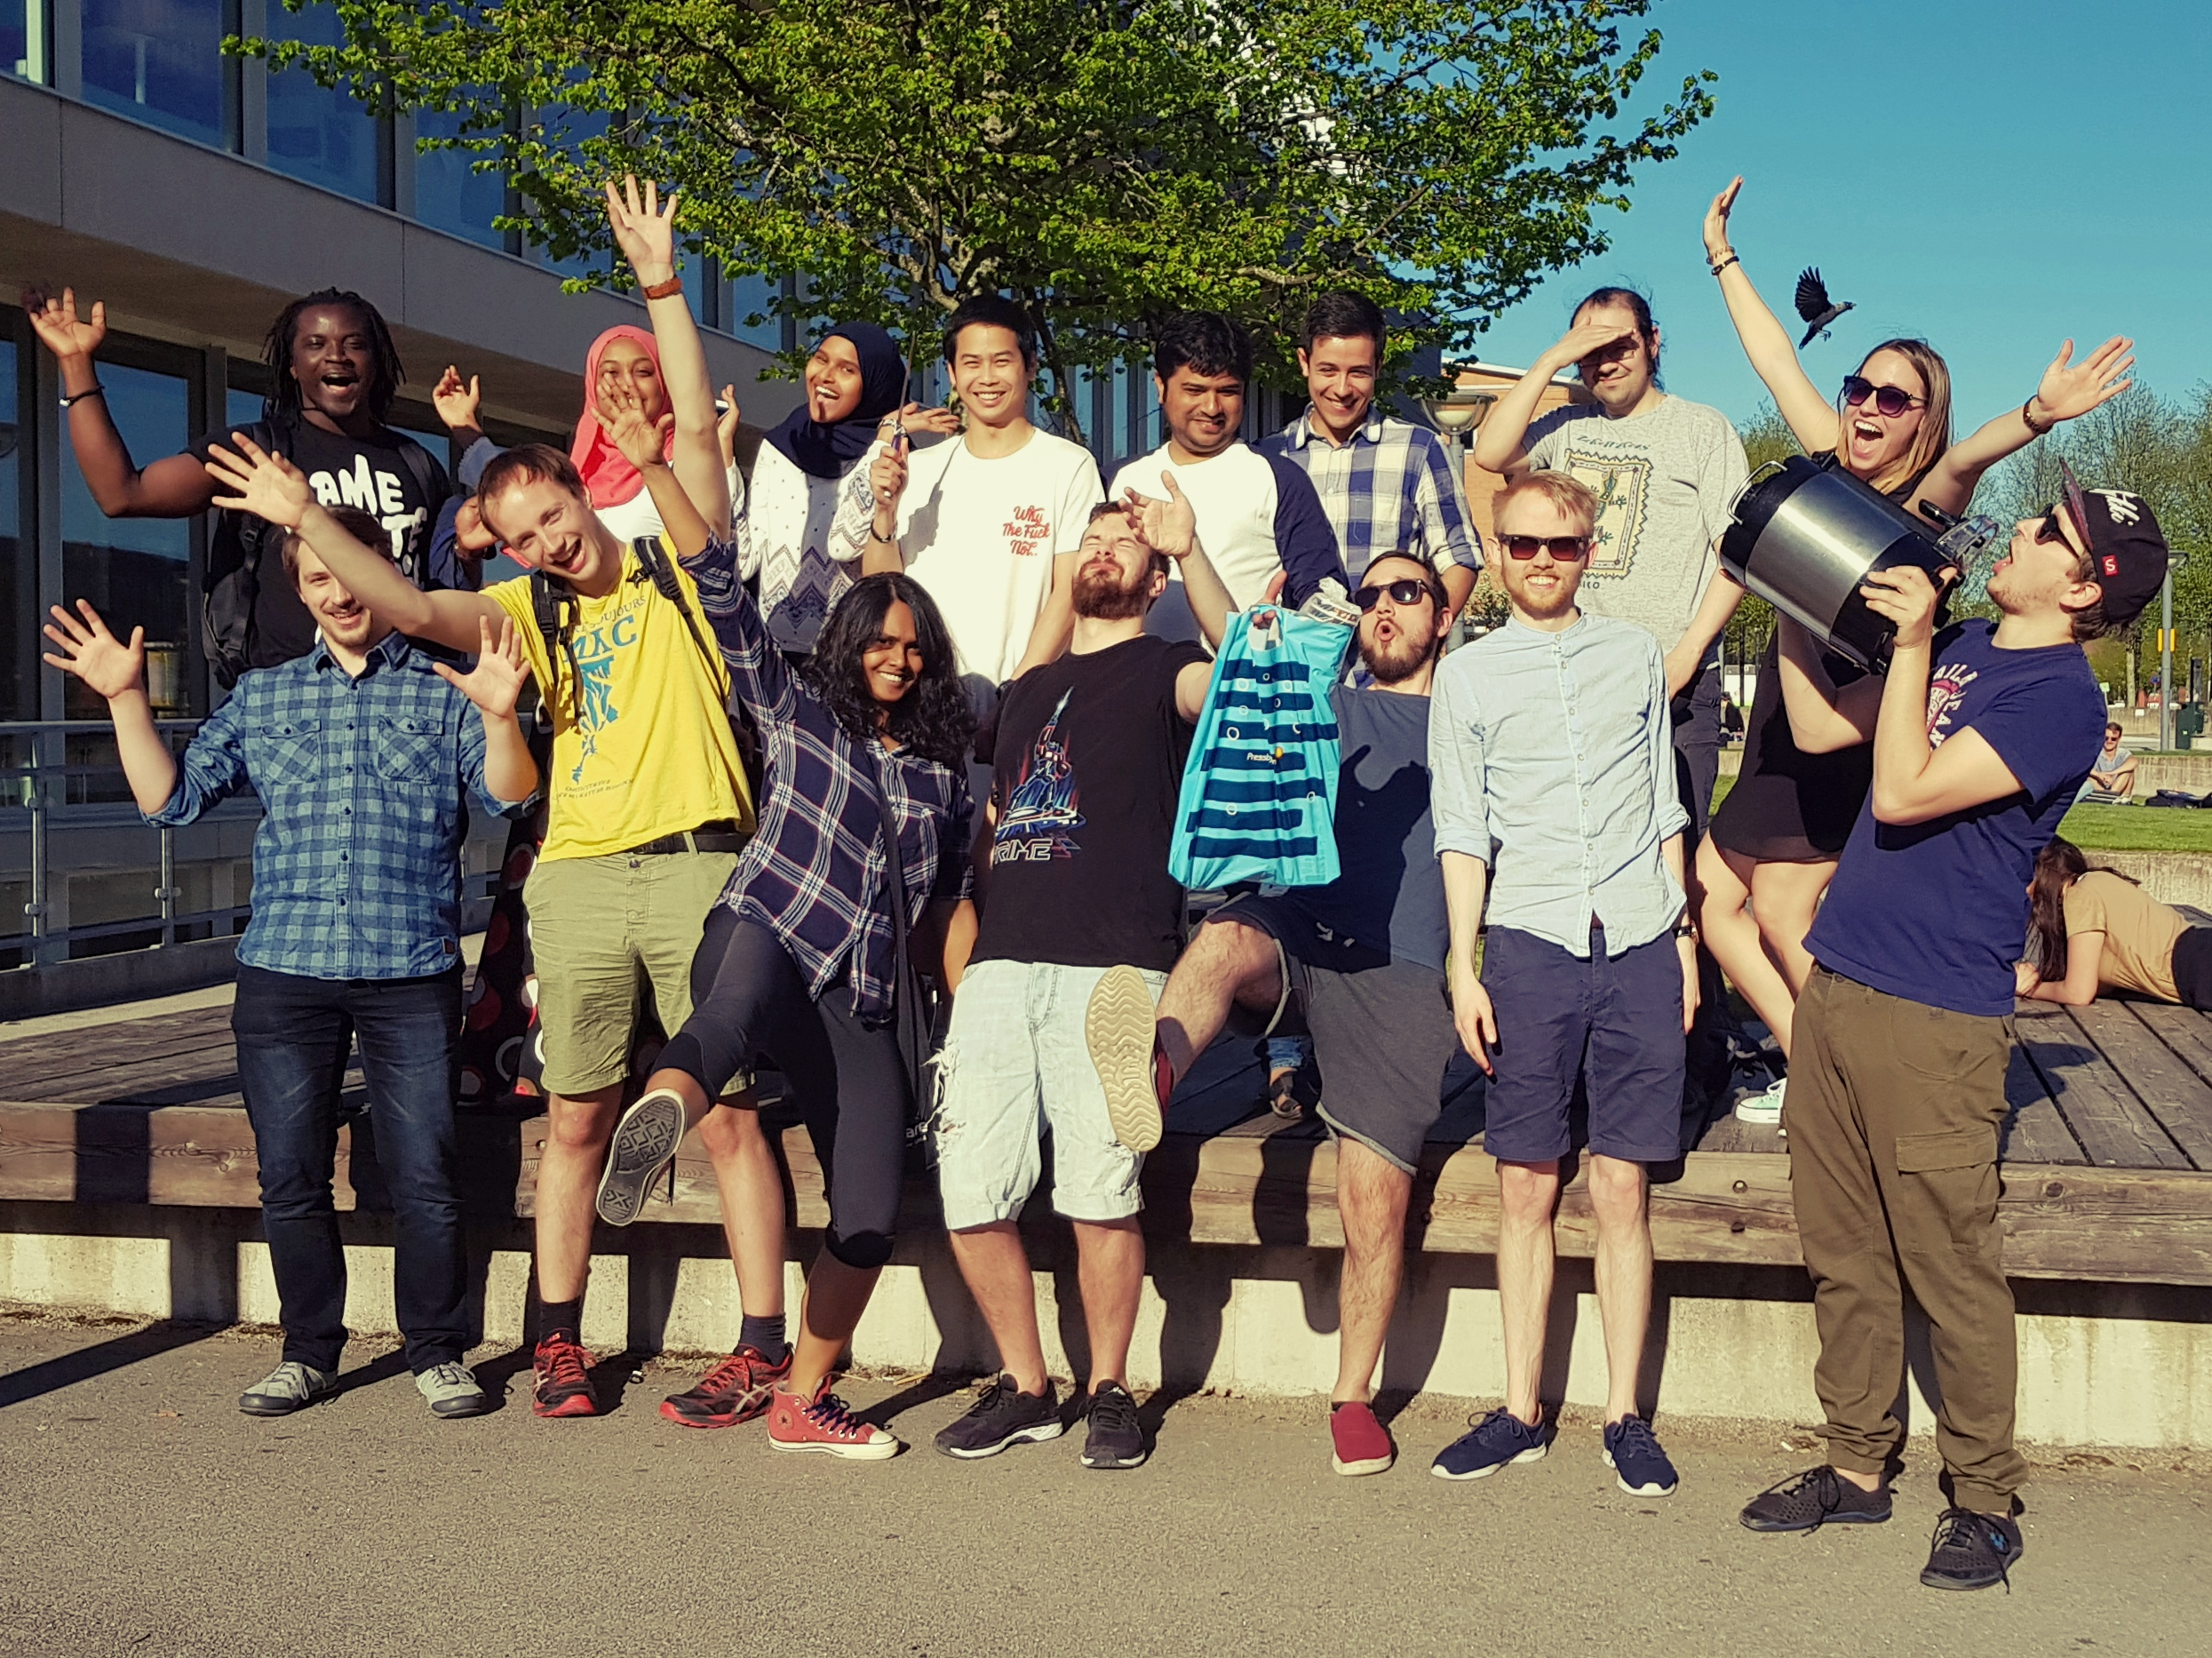
WHO IS KODKOLLEKTIVET?

Slide 4
WHO IS KODKOLLEKTIVET?

Slide 5
WHO IS KODKOLLEKTIVET?

Slide 6
WHAT DOES KODKOLLEKTIVET DO?

Slide 7
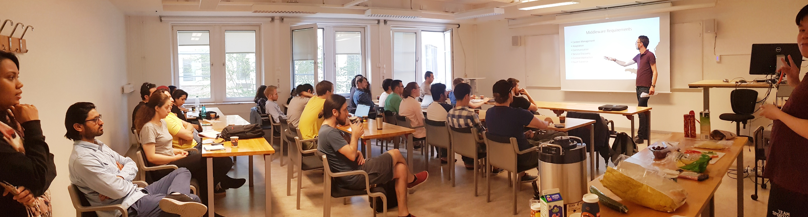
WHAT DOES KODKOLLEKTIVET DO?
Every two weeks: Code Hub

Slide 8





WHAT DOES KODKOLLEKTIVET DO?
Every two weeks: Code Hub
Lunch lectures with companies

Slide 9
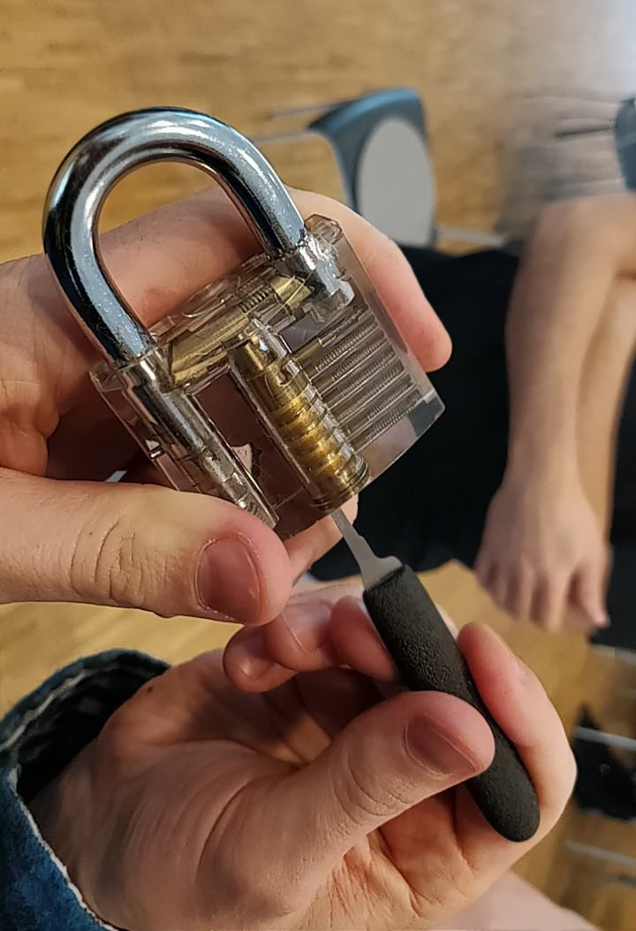
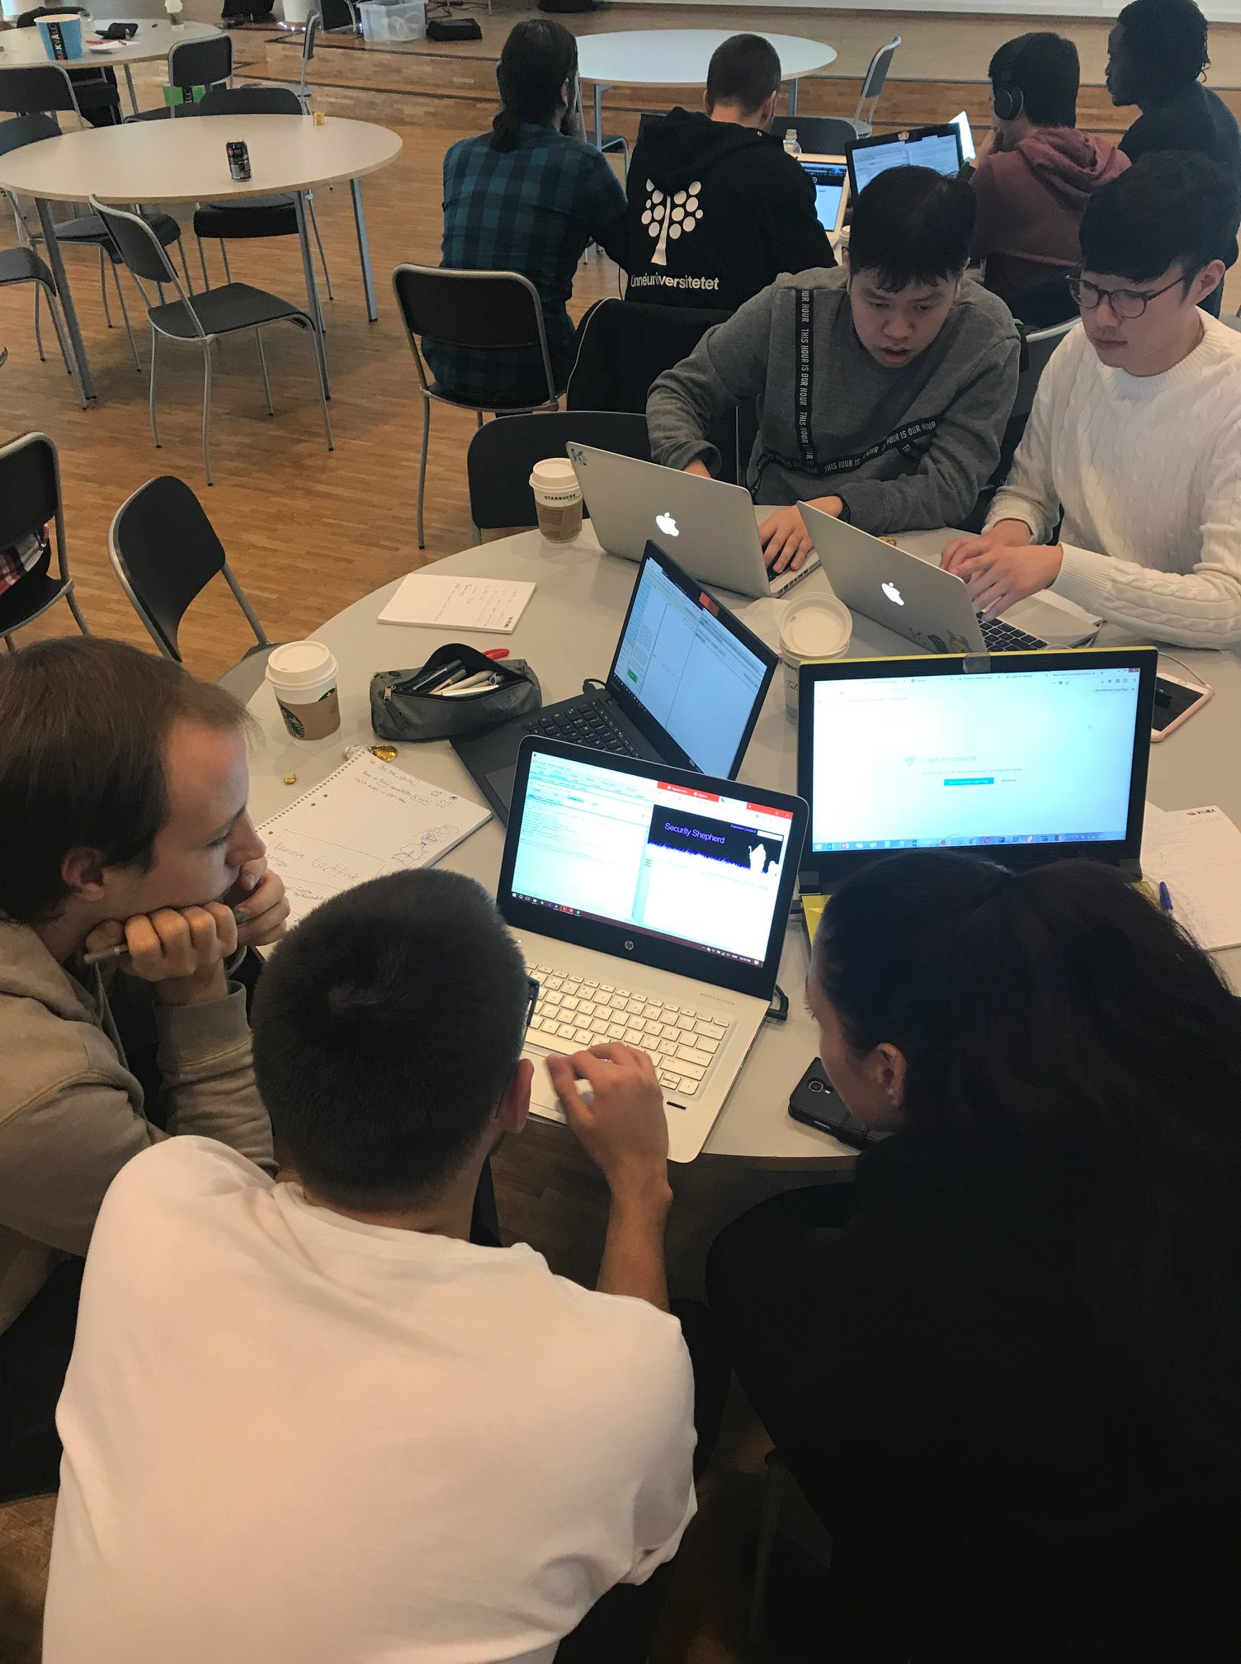
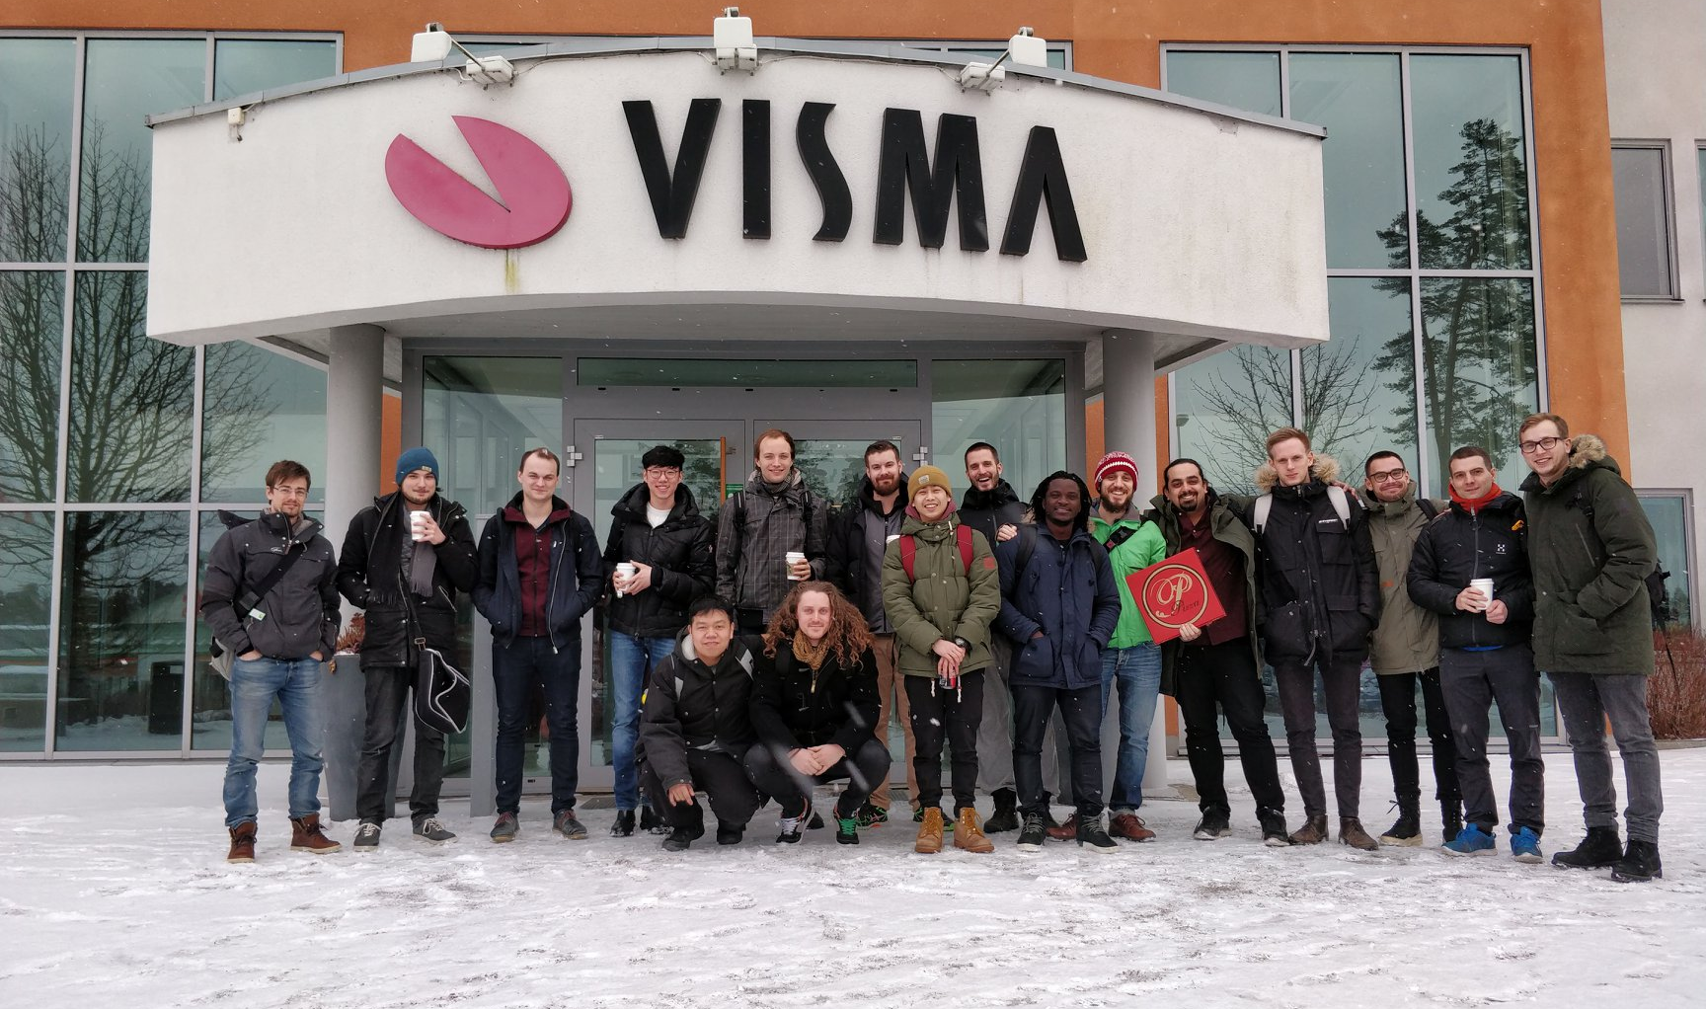
WHAT DOES KODKOLLEKTIVET DO?
Every two weeks: Code Hub
Lunch lectures with companies
Hackathons + events at companies

Slide 10
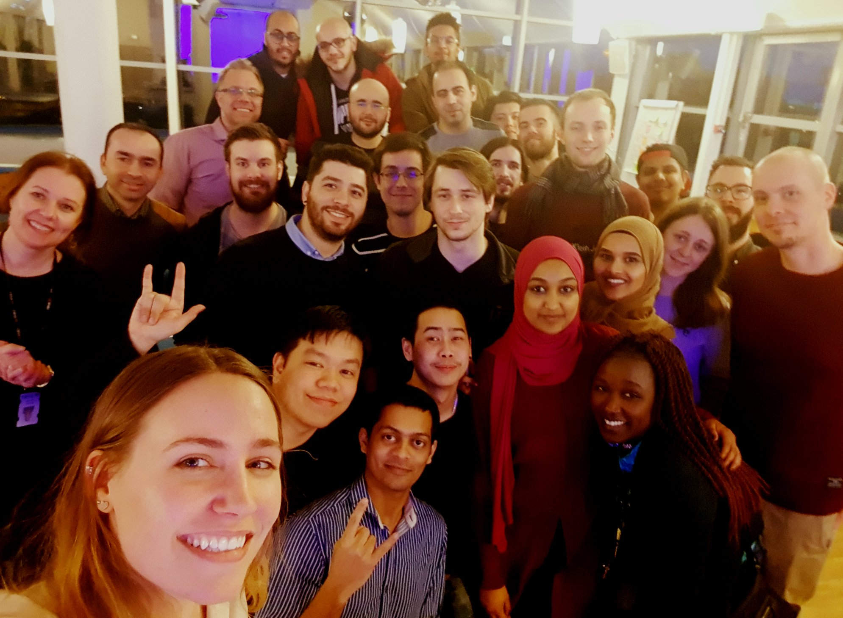




WHAT DOES KODKOLLEKTIVET DO?
Every two weeks: Code Hub
Lunch lectures with companies
Hackathons + events at companies

Slide 11
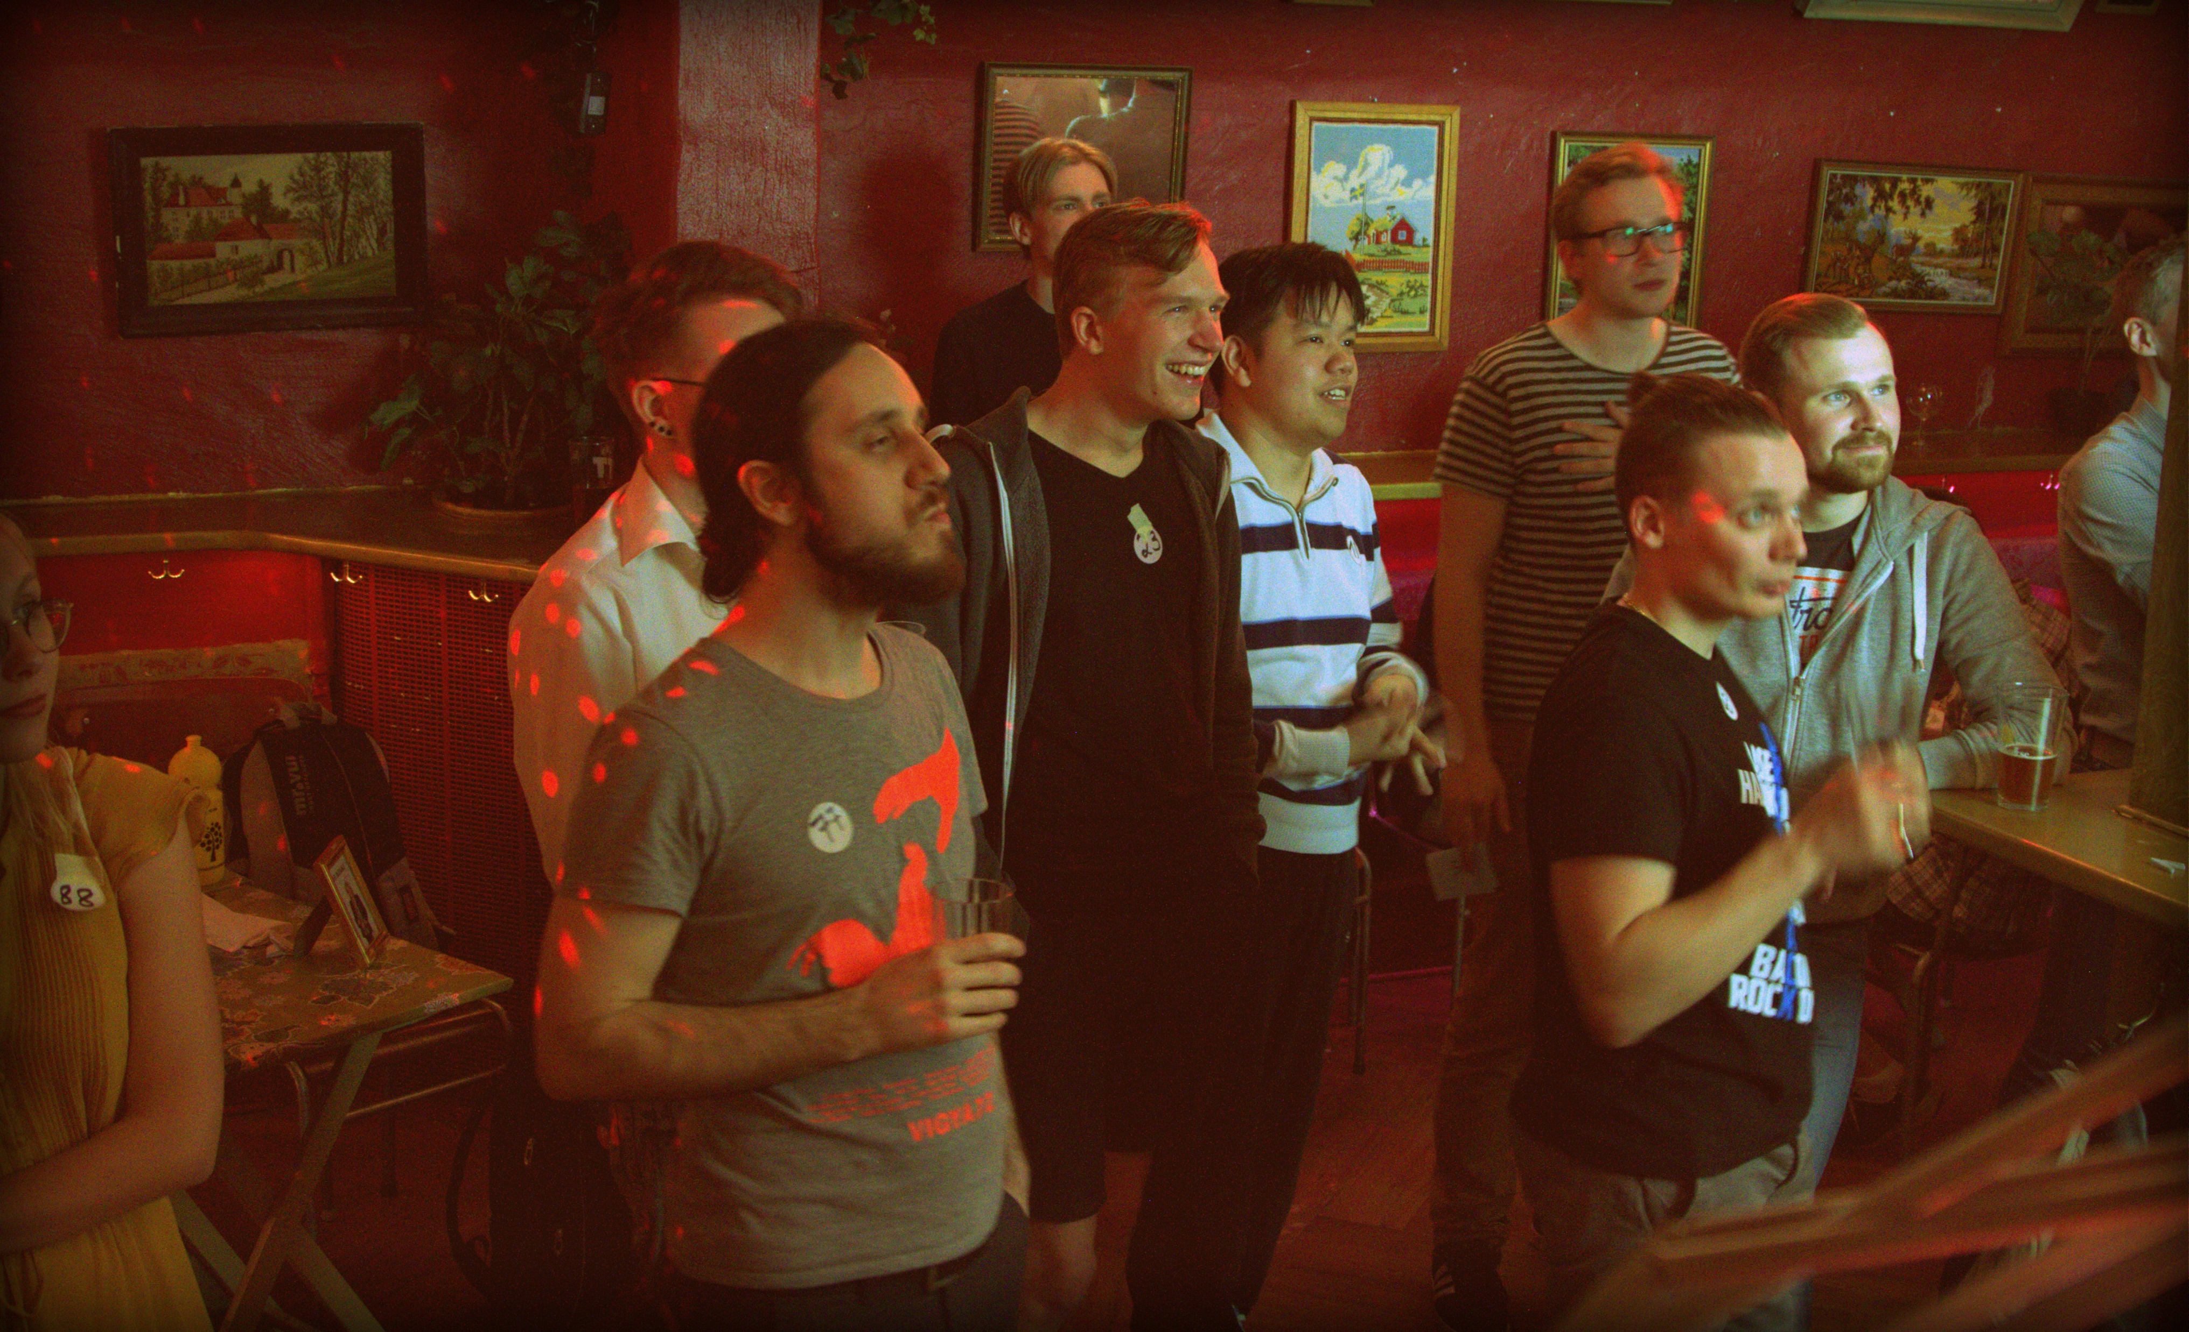

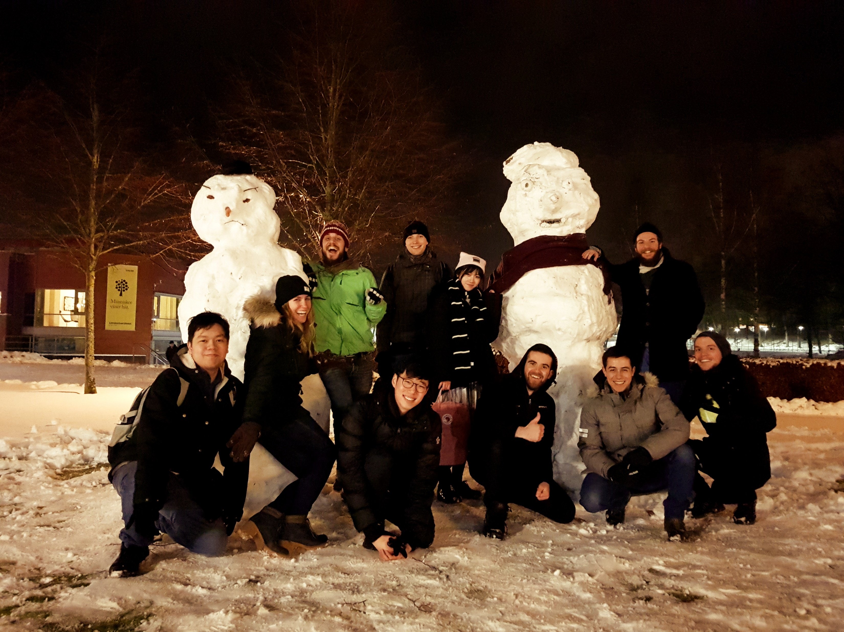
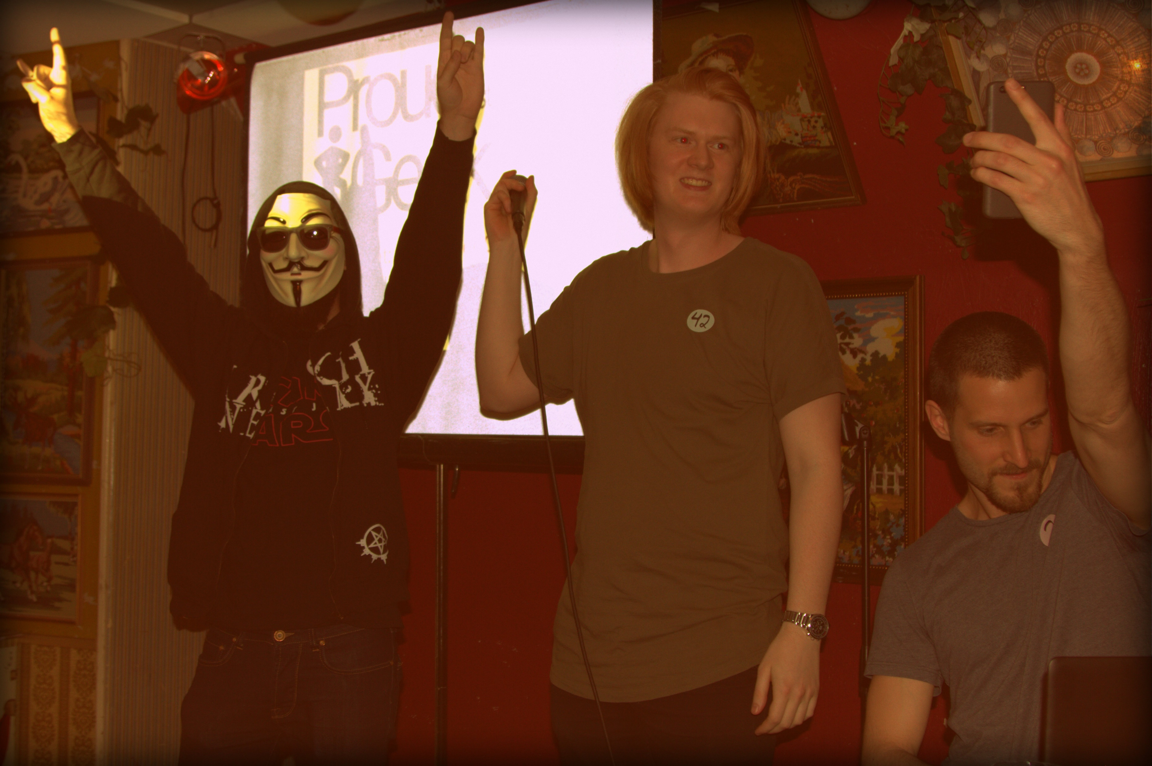
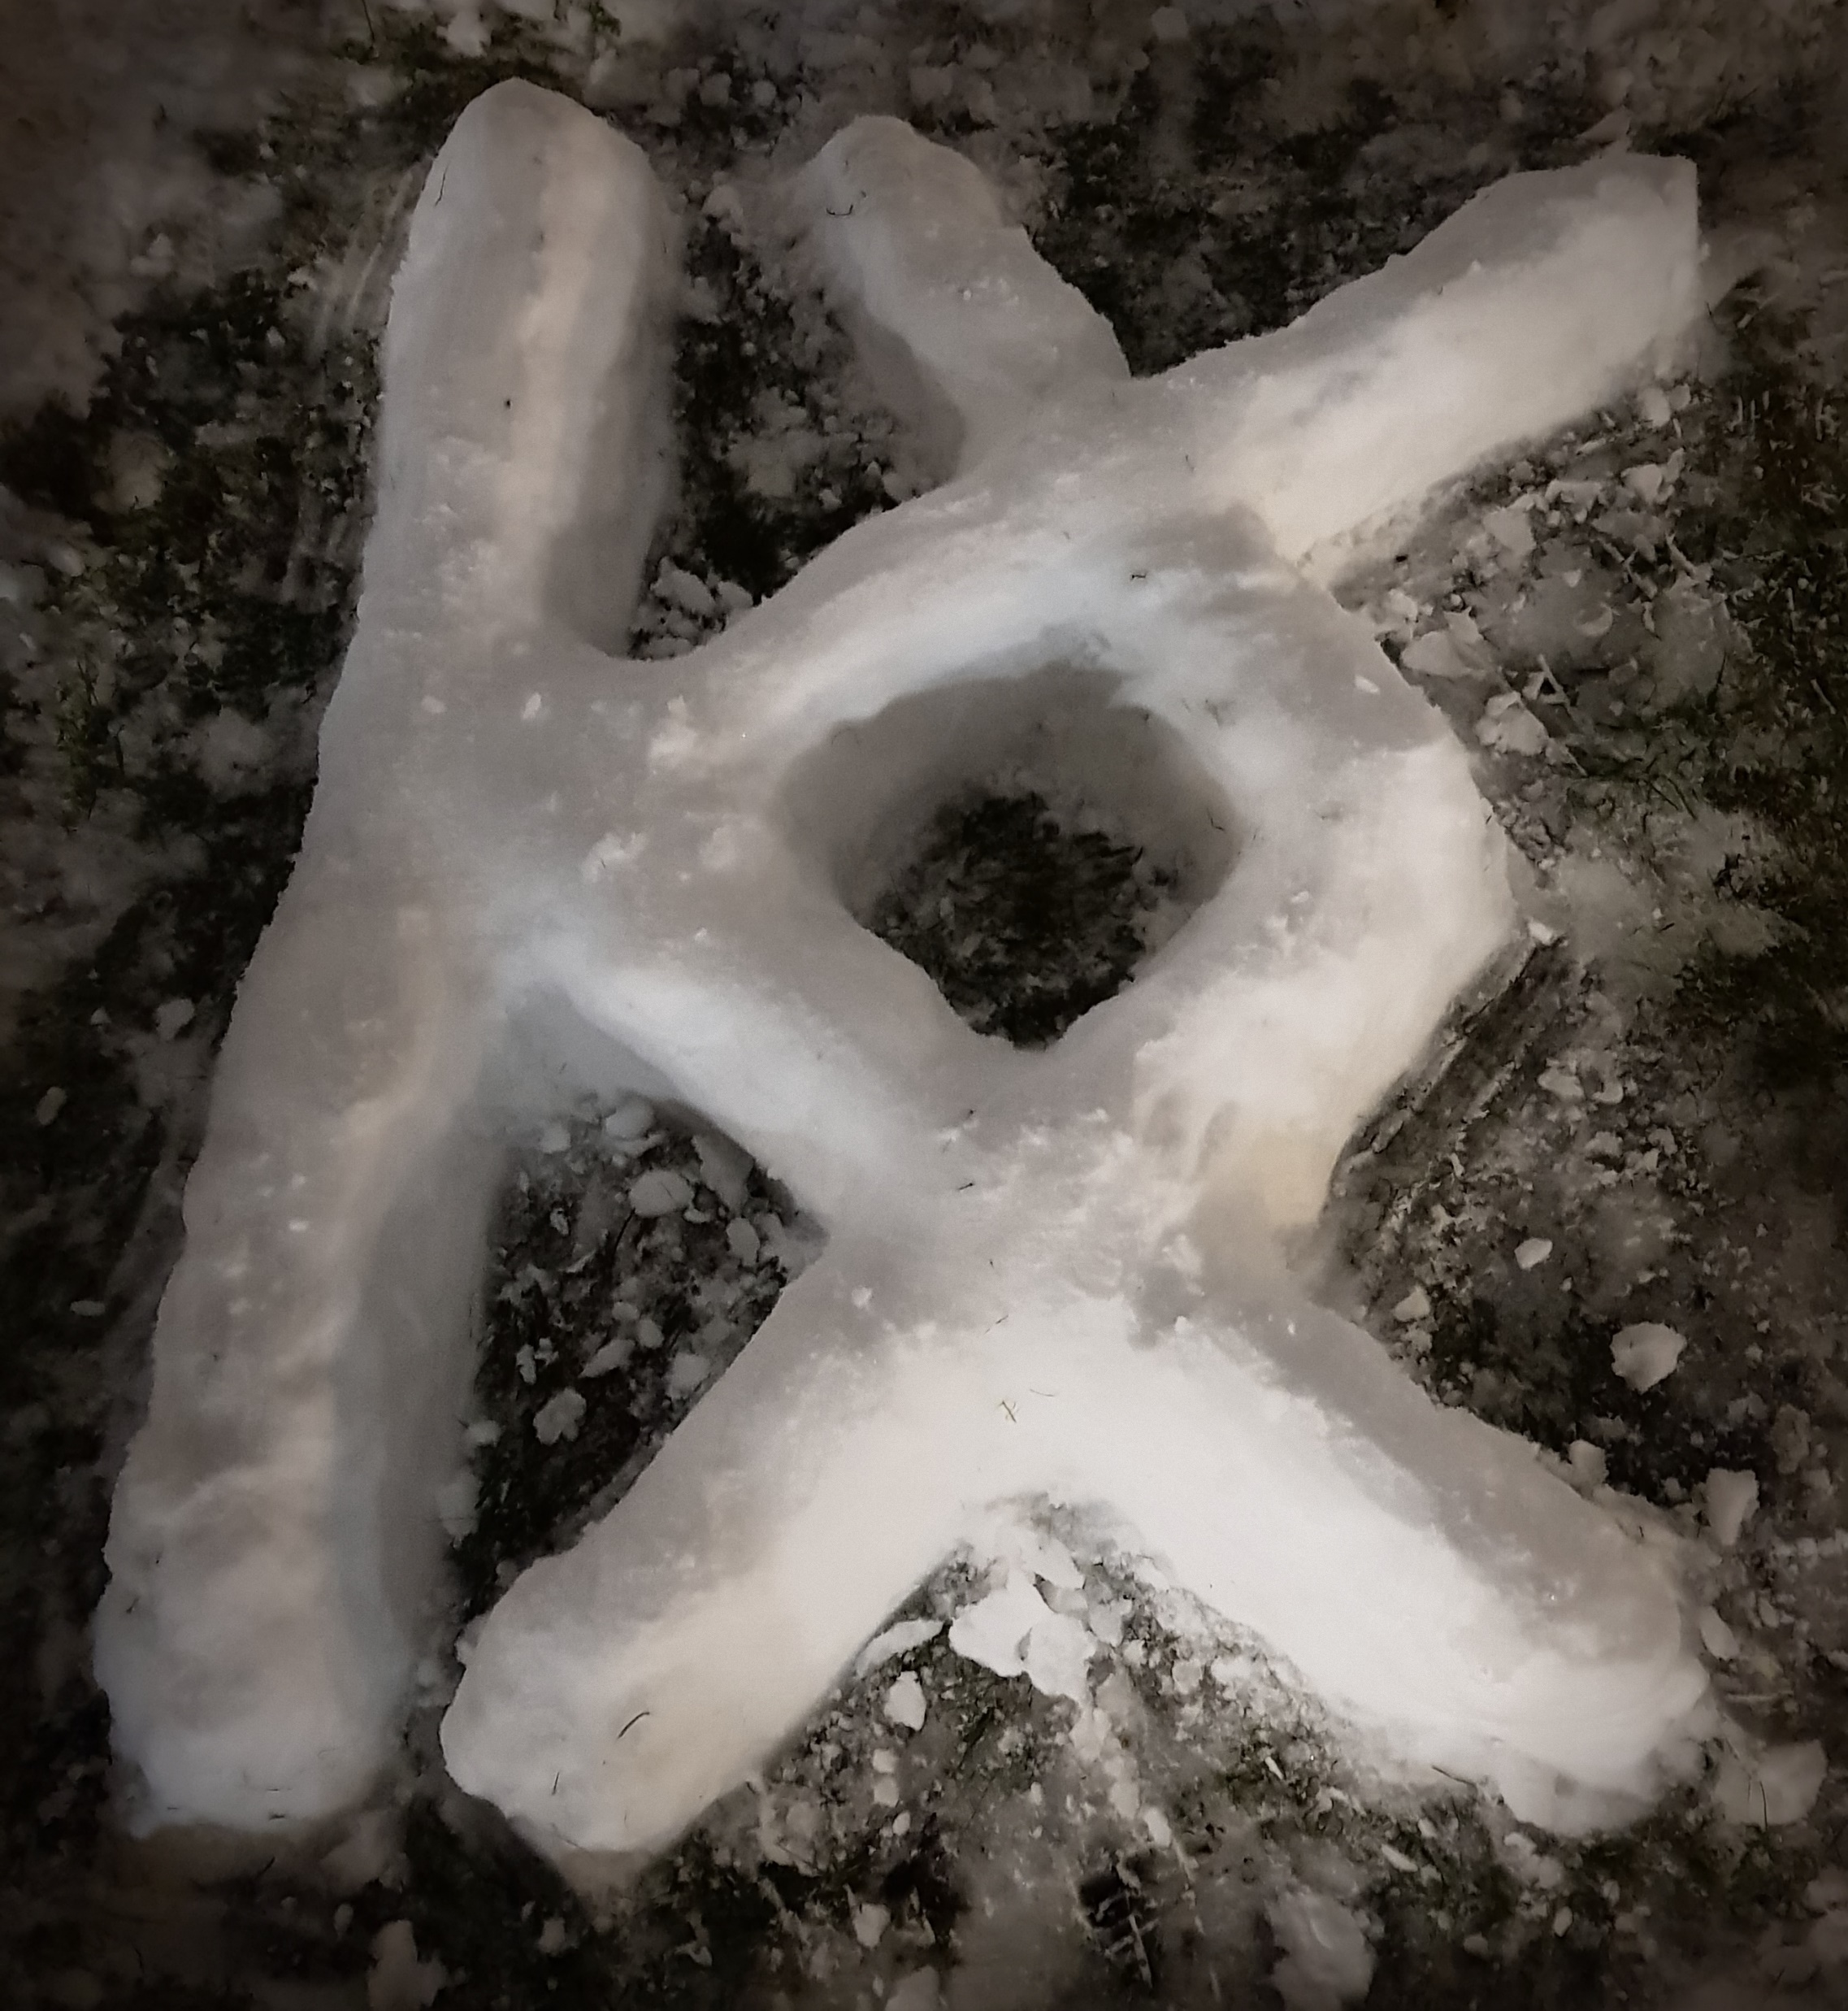
WHAT DOES KODKOLLEKTIVET DO?
Every two weeks: Code Hub
Lunch lectures with companies
Hackathons + events with companies
FUN PART

Slide 12

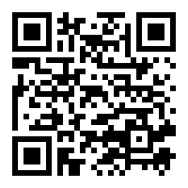

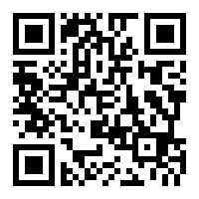
HOW TO CONNECT WITH US
kodkollektivet.slack.com
→ communication channel for members
https://www.facebook.com/kodkollektivet/
→ updates on events, pictures, and more

